Slide 1

HELLO!
Here 1Crore Projects
I am here because I love to give presentations.
You can find me at @1CROREPROJECTS

Slide 2
A Study on Prediction of cancer using Data mining Techniques With CNN Algorithm

Slide 3

AIM OF PROJECT
The main aim of this model is toprovide the earlier warning to the users and it is also cost
efficient to the user. Finally a prediction system is developedto analyze risk levels which help in prognosis

Slide 4
ABSTRACT
Cancer is one of the major problem today,diagnosing cancer in earlier stage is still challenging for doctors. Identification of genetic and environmental factorsis very important in developing novel methods to detect and prevent cancer. Therefore a novel multi layered method combining clustering and decision tree technique is used to build a cancer risk prediction system. The pro posed system is predicts lung, breast, oral, cervix, stomach and bloodcancers and it is user friendly and cost saving. This research uses data mining techniques such as classfica tion,clustering and prediction to identify potential cancerpatients. We have proposed this cancer prediction systembased on data mining techniques.

Slide 5
INTRODUCTION
Cancer is a potentially fatal disease caused mainlyby environmental factors that mutate genes encodingcritical cell-regulatory proteins. The resultant aberrant cell behavior leads to expansive masses of abnormal cells thatdestroy surrounding normal tissue and can spread to vitalorgans resulting in disseminated disease, commonly a harbinger of imminent patient death. More significantly,globalization of unhealthy lifestyles, particularly cigarettesmoking and the adoption of many features of the modern Western diet (high fat, low fiber content) will increase cancer incidence.

Slide 6
EXISTING SYSTEM
This system is validated by comparing its predicted results with the patient’s prior medical record and also this is analyzed using weka system.
This prediction system is available in online, people can easily check their risk and take appropriate action based on their risk status. The performance of the system is better than the existing system.

Slide 7
DISADVANTAGES
Most of the tools used for data mining are complex and require trained and specialized professionals to handle them.
Although it is a reliable set of techniques, data mining is not infallible and does not always provide completely accurate information.

Slide 8
PROPOSED SYSTEM
An architecture data mining technique based cancer prediction system combining the prediction system with mining technology was used. In this model we have used one of the classification algorithms called decision tree.
Once the user enters into the cancer prediction system, they need to answer the queries, related to genetic and non genetic factors. Then the prediction system
assigns the risk value to each question based on the user responses. Once the risk value is predicted, the range of the risk can be determined by the prediction system.

Slide 9
ADVANTAGES
Automatic pattern discovery is a strategic advantage, and this technique helps in modeling and predicting future behavior.
Trend Analysis: Understanding trends keeps you up-to-date with current developments in the industry, and helps reduce costs and timeliness to market.
Fraud Detection: Data Mining techniques help in fraud detection by discovering anomalies in datasets. ...

Slide 10
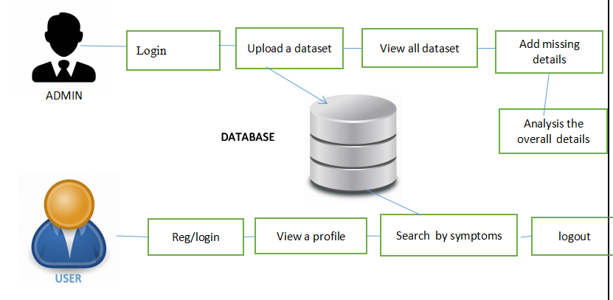
SYSTEM ARCHITECTURE

Slide 11
MODULES
In this project has two modules:
Admin
User

Slide 12
ADMIN
Login the account with correct username and password
Upload cancer related data set
View all datasets
Disease search by id after click in check over all risk disease
Add data missing
Clustering search by id
Analysis the overall disease
logout

Slide 13
USER
Register the account
Login the account with correct username and password
View user profile
Search by symptoms
Logout

Slide 14
HARDWARE REQUIREMENTS
System | Intel i3 and above
Hard Disk | 100GB
RAM | Minimum 4GB
Processor | 64-bit, four-core, 2.5 GHz minimum per core

Slide 15
SOFTWARE REQUIREMENTS
Front End Language | HTML, CSS, JAVA, JSP SERVELTS
Backend | My SQL
Operating System | Windows 10 or 11
IDE | JAVADEVELOPEMENTKIT

Slide 16
FUTURE WORK
In future work the others in such way that it could be declared the optimal algorithm and none of the algorithm performed poorly as to be eliminated from future prediction model in breast cancer survivability tasks.

Slide 17
CONCLUSION
Cancer is potentially fatal disease. Detecting cancer is still challenging for the doctors in the field of medicine. Even now the actual reason and complete cure of cancer is not invented. Detection of cancer in earlier stage is curable. In this work we have developed a system called data mining based cancer prediction system. The main aim of this model is to provide the earlier warning to the users and it is also cost and time saving benefit to the user. It predicts three specific cancer risks. Specifically, Cancer prediction system estimates the risk of the breast, skin, and lung cancers by examining a number of user_x0002_provided genetic and non-genetic factors.

Slide 18
REFERENCE
[1] Max Roser and Hannah Ritchie, “CANCER”;Our World In Data; 2020
[2] Plummer M, Vignat J, Ferlay J, Franceschi S, de Martel C, Bray F.
[3] International Agency for Research on Cancer, 2014, Stewart BW, Wild CP
[4.]Global Initiative for Cancer Registry Development. International Agency for Research on Cancer

Slide 19
[5] itu Chauhan “Data clustering method for Discovering clusters in spatial cancer databases” International Journal of Computer Applications (0975-8887) Volume 10-No.6, November 2010.
[6]Dechang Chen “Developing Prognostic Systems of Cancer Patients byEnsemble Clustering” Hindawi publishing corporation, Journal of Biomedicine and Bio technology Volume 2009, Article Id 632786.
[3] S M Halawani “A study of digital mammograms by using clustering algorithms” Journal of Scientific & Industrial Research Vol. 71,

Slide 20
THANKS!
Any questions?
You can find me at
Reach us – 1croreprojects@gmail.com
Contact / Whatsapp: 7708 150 152 / 9751 800 789 / 790 432 0834

